Slide 1

CSG1105 / CSG5130
Applied Communications
Chapter 22
Security Hardware

Slide 2
Objectives
Describe the different security vulnerabilities associated with communication media
Explain the security advantages of a managed switch and the vulnerabilities of switches and switched LANs
Discuss the different types of firewalls and their impact on network security

Slide 3
Objectives (cont’d.)
Understand the need for IDS hardware and where it must be placed within a network
Describe the different types of biometric technology used for authentication
Explain how fault tolerance is achieved in a computer and in a network and why it is needed

Slide 4
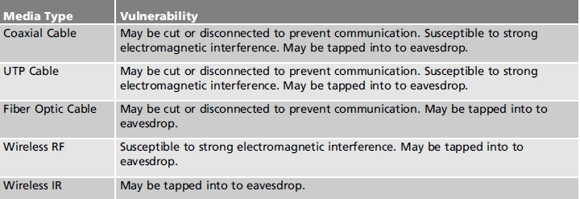
Media Vulnerabilities
Communication vulnerabilities
  Interference with uninterrupted communication
  Third party eavesdropping
Table 22-1 Communication media and their vulnerabilities

Slide 5
Media Vulnerabilities (cont’d.)
Vulnerabilities differ by media type
All media allow eavesdropping
  Process enabling eavesdropping differs
Fiber optic cable
  Most difficult media to tap into
Wireless media
  Easiest media to tap into
    War driving technique possible

Slide 6
Managed Switches
Allow control over device connections
  VLANs manage bandwidth
  Broadcast traffic contained within each VLAN
  Control over port parameters
    Speed, half duplex or full duplex, quality of service, and port enabled
  Maintains port statistics
    Bytes transmitted and received
    Link status
    Errors

Slide 7
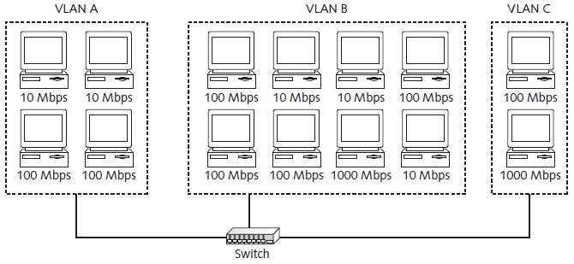
Managed Switches (cont’d.)
Figure 22-2 Managed switch controlling 14 computers

Slide 8
Managed Switches (cont’d.)
Security vulnerabilities in a switch
  Switch operation
    Switch learns MAC addresses associated with ports
    Forwards received frame to specific port
    Generally more secure than hub
  Enabling switch broadcast traffic
    Send lots of frames containing bogus MAC addresses
    Send broadcast protocol (send series of ARP frames with different IP addresses)

Slide 9
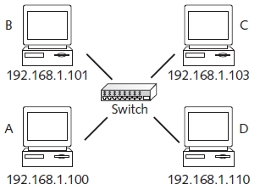
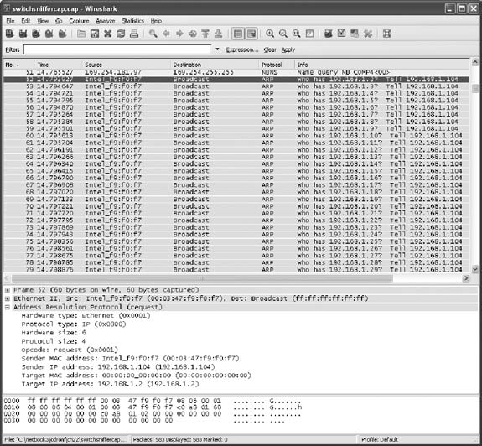
Figure 22-3 Network example
for ARP discovery scenario
Figure 22-4 Actual traffic during computer discovery via ARP

Slide 10
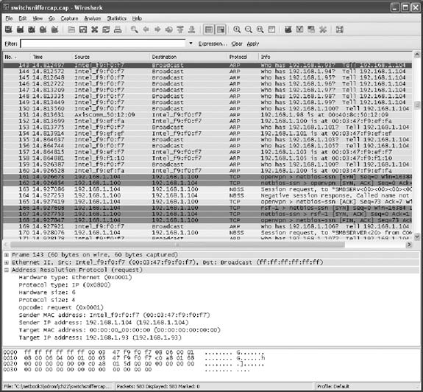
Figure 22-5 Computers responding to ARP requests
from 192.168.1.104

Slide 11
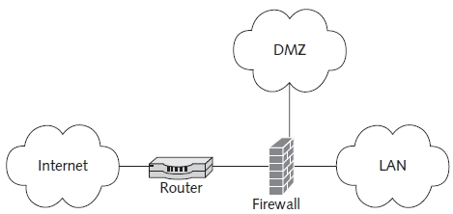
Firewalls
Hardware or software
Limit network traffic
  Coming into a network or computer
  Leaving a network or computer
Hardware firewall protects entire network
Figure 22-6 Protecting a network with a firewall

Slide 12
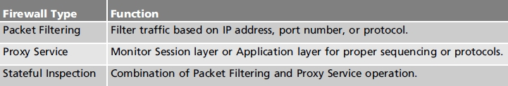
Firewalls (cont’d.)
Three firewall types
Demilitarized zone (DMZ)
  Unsecure network
    Between public Internet and private LAN
  Hardening
    Process of making a server more secure
Table 22-2 Firewall types and their function

Slide 13
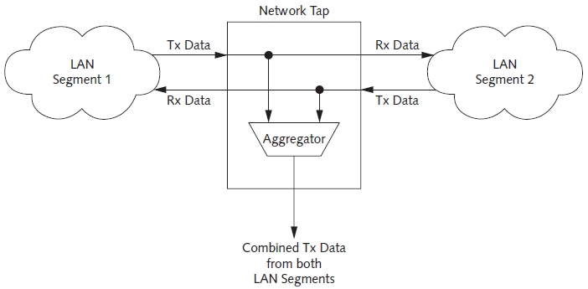
IDS Hardware
Hardware and software combination
  Detects malicious network traffic
Two parts: network tap and IDS analysis software
Figure 22-7 Basic operation of a network tap

Slide 14
Authentication
Process of identifying user to a computer (any other third party
Three ways computer user is authenticated:
  Something you know
  Something you have
  Something you are
Multi-factor authentication
  Using more than one authentication method

Slide 15
Biometric Devices
Use physical feature of one’s body
  Assists in authentication
  Individual biometric measurements make up biometric signature
Wide variety of biometric devices available
  L east expensive
    Devices recognizing fingerprints
  Most expensive
    Iris or retinal scanners

Slide 16
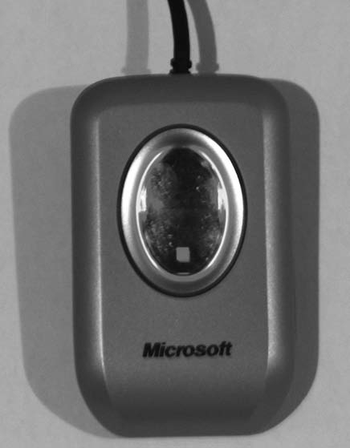
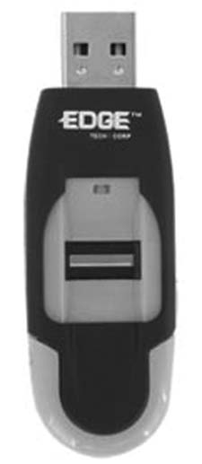
Biometric Devices (cont’d.)
Fingerprint readers
  Most common biometric device
Figure 22-8 Two biometric devices
used to authenticate via fingerprint:
(a) Microsoft fingerprint reader
Figure 22-8(b) USB flash
drive with fingerprint
authentication

Slide 17
Biometric Devices (cont’d.)
Fingerprint readers (cont’d.)
  Make two-dimensional fingerprint plot
    Use actual image or two-dimensional plot of the distances between fingerprint sensor and skin
    Fingerprint recognized based on unique characteristics in the plot
    Capacitive fingerprint sensor “sees” different capacitances
  Once fingerprint registered:
    Usable for authentication purposes

Slide 18
Biometric Devices (cont’d.)
Voice authentication
  Voice recognition
    Understanding what a person is saying
  Voice authentication
    Understanding who is talking
Hand geometry readers
  Capture unique characteristics of a human hand

Slide 19
Biometric Devices (cont’d.)
Handwriting authentication
  Factors building biometric template
    Varying speed, pen pressure, and stroke of the letters
  Digital graphics tablet
    Captures three dimensional signature characteristics
Facial recognition
  Facial recognition software
    Analyzes camera image
    Extracts facial characteristics (distance between eyes, nose, mouth)

Slide 20
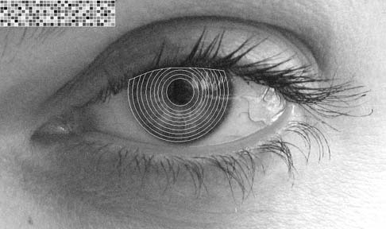
Biometric Devices (cont’d.)
Iris and retinal Scanners
  Iris scanning uses patterns in the iris
  Retinal scanning uses patterns in blood vessels of the retina at the back of the eye
Figure 22-11 Iris recognition parameters

Slide 21
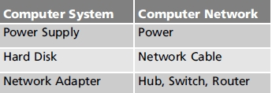
Fault Tolerance
Ability of computer (computer network) to keep operating in a hardware failure event
Many types of hardware failures
  Fatal if system not fault tolerant
Table 22-3 Hardware failures in a computer
system and computer network

Slide 22
Fault Tolerance (cont’d.)
Adding fault tolerance to a computer system
  Avoiding power loss
    Use an Uninterruptable Power Source (UPS)
    Use dual power supplies
  Avoiding hard disk failure
    RAID Level 1 Disk Mirroring
    RAID Level 5 Stripe Sets with Parity

Slide 23
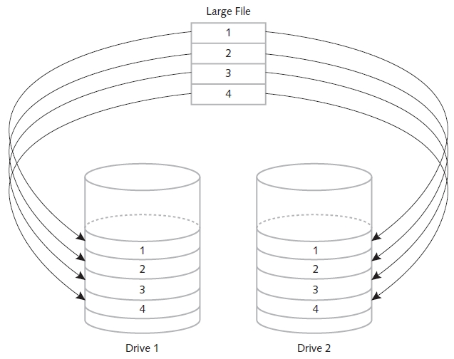
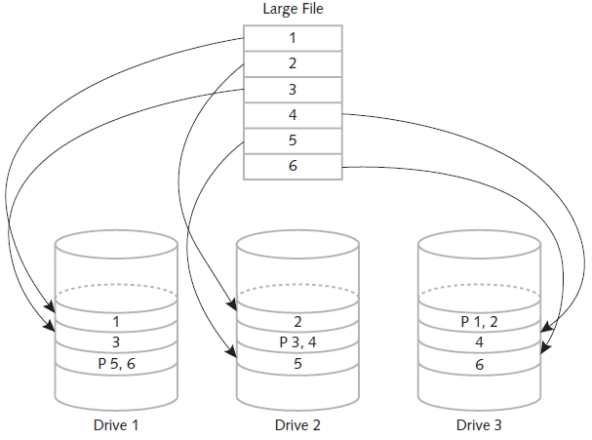
Fault Tolerance (cont’d.)
Figure 22-14 RAID Level 5
Stripe Sets with Parity
Figure 22-13 RAID Level 1
Disk Mirroring

Slide 24
Fault Tolerance (cont’d.)
Adding fault tolerance to a computer network (cont’d.)
  Power loss protection
    Use a UPS or multi-homed computers
  Protecting network as a whole
    Provide reliable connections from user computers to LAN servers
    Provide fault tolerance in LAN to Internet connection
  Fault tolerance for user computers
    Use multi-homed computers connecting to different switches

Slide 25
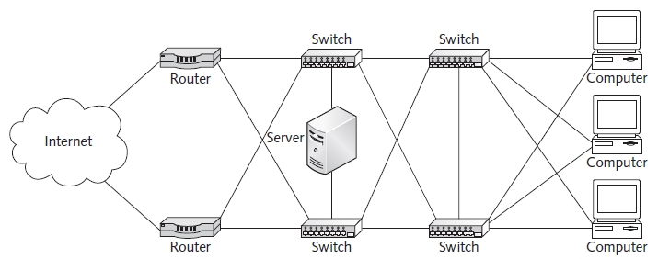
Fault Tolerance (cont’d.)
Figure 22-15 Providing fault tolerance on a LAN

Slide 26
Physical Security
Site location
  First line of defense against intruders
Moat
  Prevents all but most serious individuals from attempting access
    Wide and deep enough to prevent vehicle crossing
Lighting
  Provide well lit facilities inside and outside
Fences
  Prevent most individuals from approaching the building

Slide 27
Physical Security (cont’d.)
Mantrap
  Secure area entryway area containing two doors
Cameras
  Use motion detecting cameras, night vision cameras, and cameras designed for operation in bright sunlight
    Available for use over wired or wireless networks
  Use on doors, windows, in hallways
Motion and/or heat sensors
  Defer intruders

Slide 28
Physical Security (cont’d.)
Doors and locks
  Use strongly built doors blocking secure area access
  Use numerical combination lock, swipe card lock, and biometric device
Windows
  Keep closed; monitor with an alarm system
  Frosted to obscure view through them, still allow monitoring
Physical security plan
  Describes procedures required for maintenance, evacuation due to emergency, and shutdowns

Slide 29
Troubleshooting Techniques
Patience
  May need to work on a problem for hours, days or weeks before finally solving it
Reward for sticking with it
  Satisfaction of a job well done
  Valuable experience

Slide 30
Summary
Communication media susceptible to vulnerabilities
Managed switch controls device connections
Firewall: limits network traffic in and out
IDS detects malicious network traffic
Biometric devices use physical feature of one’s body to assist in authentication
Fault tolerance
  RAID Level 1 and 5, UPS, dual power supplies, and multi-homed computers
Physical security factors protect computers

